Slide 1
What is Tableau?
Tableau is a powerful and fastest growing data visualization tool used in the Business Intelligence Industry.
We don’t need any prior coding skill or technical background in order to learn Tableau.
These BI tools are so powerful that it can work on large amount of data & can convert it into meaningful formats.

Slide 2
Tableau Desktop
1. Connect – Connect sections allows tableau to connect with desktop files(different file type) and different database type.
File type can be ms excel, pdf, csv, json, statistical file etc
2. Open - You can open your existing workbook or workbook in which you have work earlier.
By clicking on open you can access earlier version of workbook that you have created for visualization.
3. Discover – In the discover section, we get short tutorial provided by tableau community.
Important blogs or also some important work done by all contributor in tableau community.

Slide 3
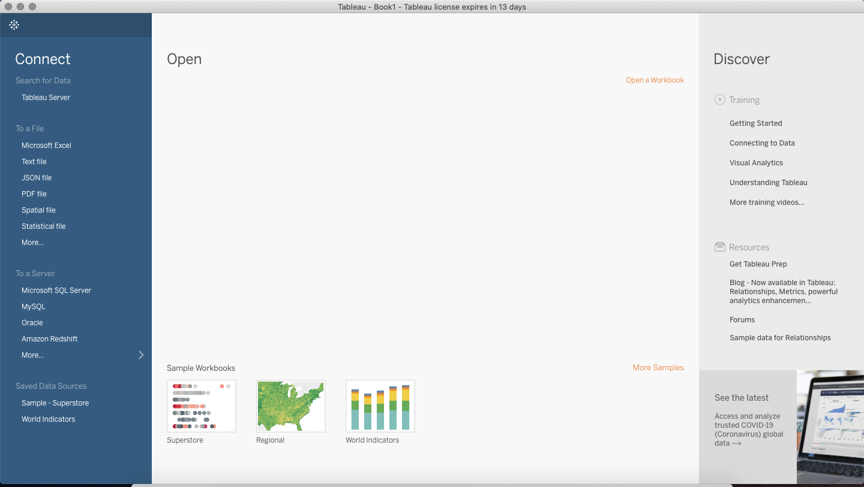

Slide 4
Process flow of BI Project
1. Business understanding
2. Data understand
3. Data Preparation
4. Modeling
5. Evaluation
6. deployment.

